Slide 1
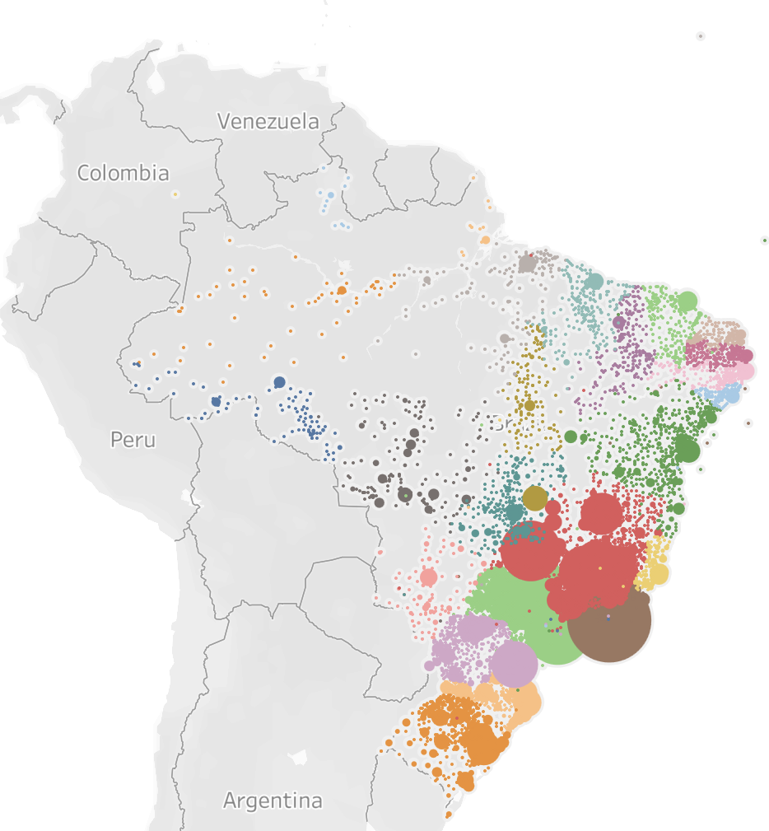
Aurelius
Use Case Discussion
Notes:
very large middle class, income extremely concentrated in southeast (rio, sp), high price sensitivity, people actually compare prices and a lot, highly connected (leads many usage metrics on whatsapp globally), ecommerce is big but still improving due to logistic challenges, I'd say mercado livre has the top position and other players like magazine luiza are very strong, amazon still figuring out it's strategy (people still go to it for books), inflation is still quite volatile and does impact willingness to consume, people are mostly happy and have active sexual lives

Slide 2
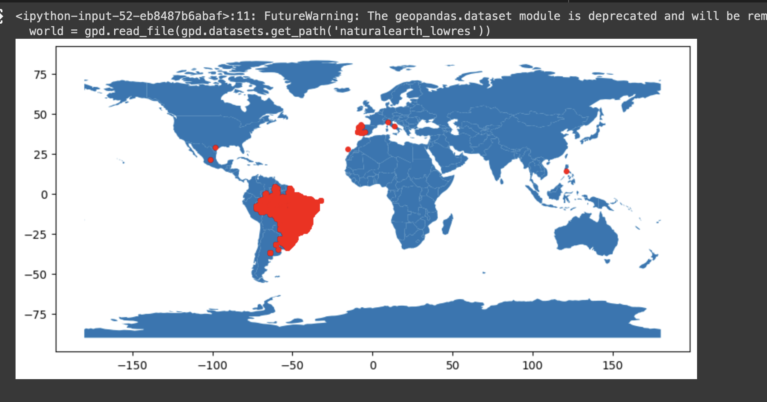

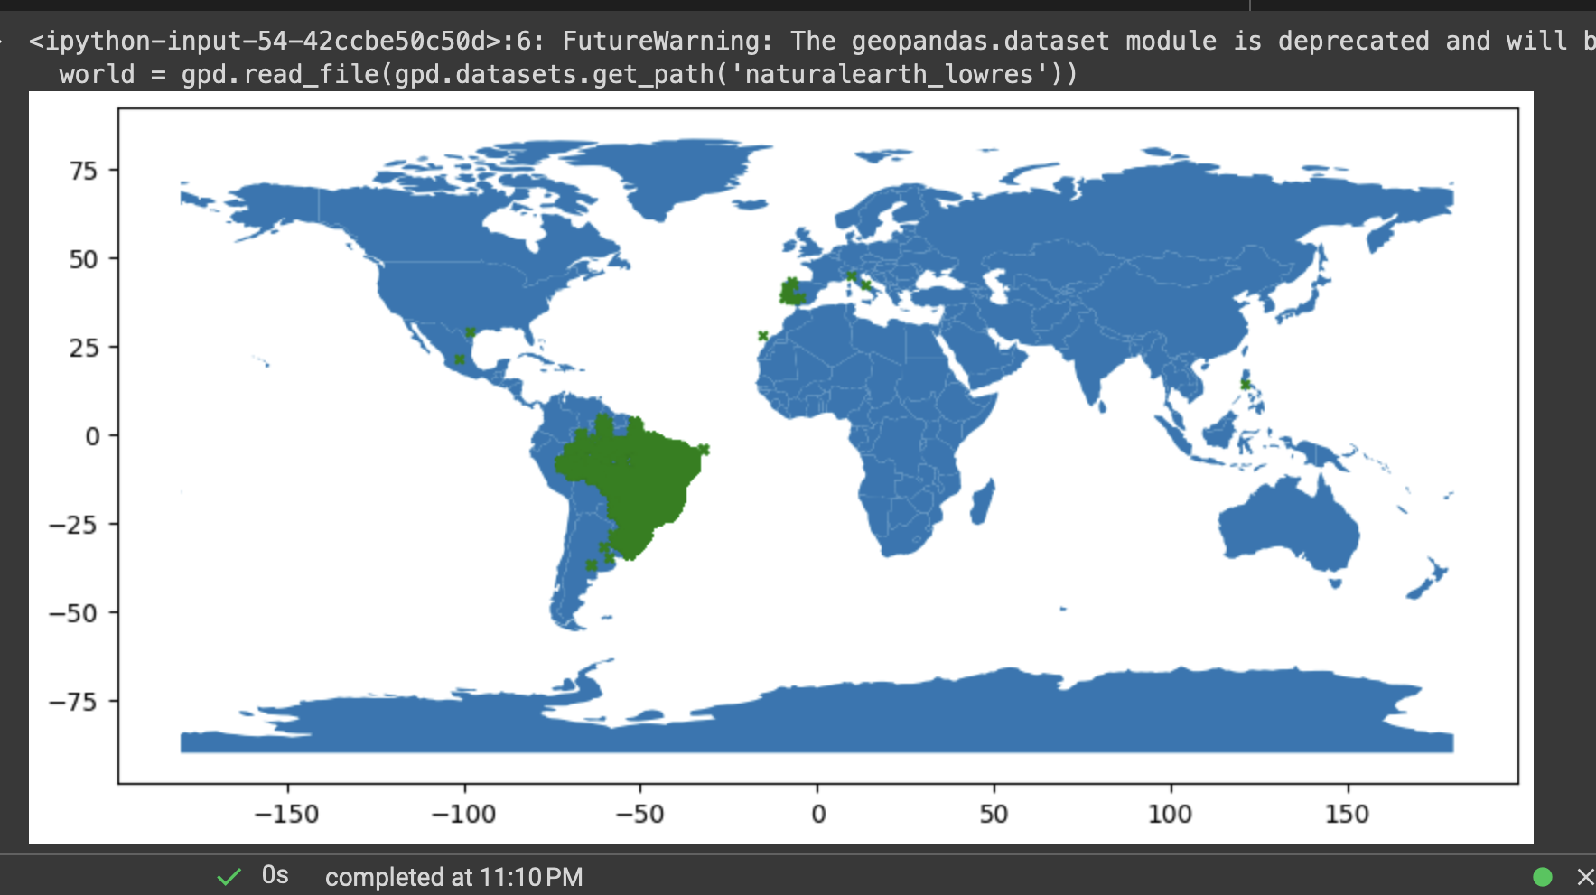
Agenda
1. Intro and Overview
2. Dataset and data quality issues
3. Solution and approach
3. Tools and Procedures
Notes:
Tools and procedures:
Discuss procedure for getting to solution.
Discuss the tools and technologies you have used.

Slide 3
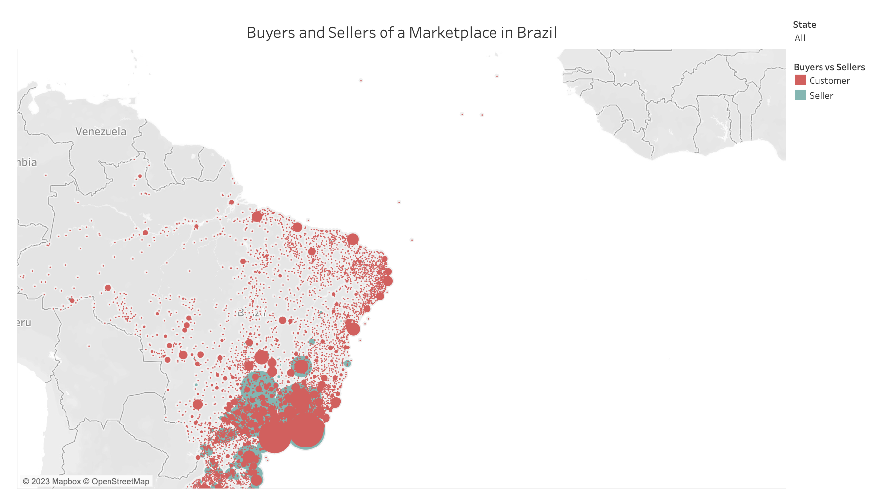




Aurelius Use Case: Intro and Overview
Overview
E-commerce Platform
Brazil in ‘18 → 210M pop., 9k GDP-capita, mostly in SE,
Economic Outlook: inflation and volatility, Logistical challenges (excl. Rio and SP)
E-commerce: stable growth with entrants and big players (Mercado Livre, Luiza etc)
User behavior→ young and connected (Whatsapp) high-tech expectation
Notes:
very large middle class, income extremely concentrated in southeast (rio, sp), high price sensitivity, people actually compare prices and a lot, highly connected (leads many usage metrics on whatsapp globally), ecommerce is big but still improving due to logistic challenges, I'd say mercado livre has the top position and other players like magazine luiza are very strong, amazon still figuring out it's strategy (people still go to it for books), inflation is still quite volatile and does impact willingness to consume, people are mostly happy and have active sexual lives
Introduction of proposed user case:
Provide a brief overview of the user case scenario relevant to the Senior Data Scientist position.
"a Brazilian e-commerce platform, has experienced a plateau in sales and a decline in buyer activity despite seller stability. The goal is to identify the root causes and propose solutions to revitalize growth."

Slide 4
Basic Framework for ML Planning
Definition of the problem and scope is always step 0 of any solution
1
2
3
4
Problem
Definition
Define Business Objective
Variable, feature definition
Limitations
and Risks
Definition of
success
Data exploration and diagnosis along with a visual representation of the analysis
We will focus on addressing and understanding the dip in Sales in Q3’18
Geo data, product specs, information about a marketplace along with transactional database extracts
1. No validation of underlying assumptions
2. Tech limitations (trial versions, Mac)
3. timeboxed exercise
Identify root cause, propose solutions and recommendations while showcasing basic toolbox of a data scientist

Slide 5
Data Exploration and Analysis
Notes:
https://medium.com/samaipata-ventures/cheat-sheet-1-key-kpis-to-track-for-marketplaces-75827d9fc0a8
Understanding of dataset:
Demonstrate your understanding of the dataset, including data quality, etc.

Slide 6
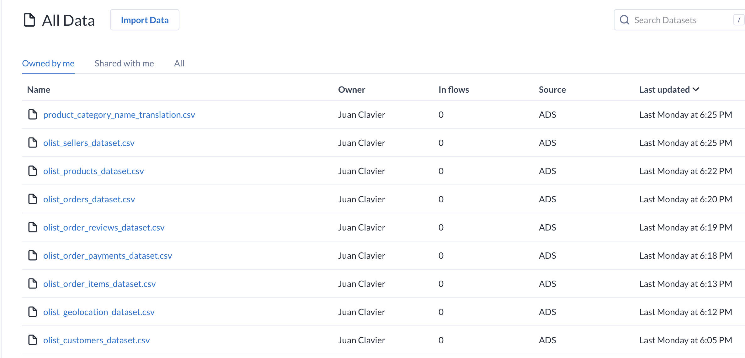
Data Overview and upload
We can identify product, customers, sellers, payments, orders and geo in the sets

Slide 7
Data Quality Testing Checklist 1/2
Upon uploading in the Cloud (via the Alteryx Data Connector).. Data quality Integrity checks were performed…
Data Sets | Description | Primary Key | Data Types | Unique Values | Null Values | Sort By | Group by | Column Names | Special Characters | Join keys % Rate
Product Translation | Portuguese to English Translation of Catalogue | product_category _name | Pass | Pass | Pass | NA | NA | Pass | Pass | NA
Product | Product Specs such as weight, length, etc | product_id | Fail | Pass | Fail | Pass | NA | Pass | Pass | Fail
Sellers | Information about sellers of the platform including geo via zip | seller_id, Zip | Pass | Pass | Pass | Fail | Pass | Fail | Pass | NA
Customers | Info about cust. of the platform incl. geo location via zip | customer_id, Zip | Pass | Fail | Pass | Pass | Pass | Fail | Pass | NA
Notes:
Suggested Action: Leverage customer feedback analytics to identify pain points and implement improvements based on data-driven insights.
For specific and accurate figures, it is recommended to refer to official reports, market research studies, and financial statements from the year 2018.

Slide 8
Data Quality Testing Checklist 2/2
Geolocation seems to be the most polluted set while Payment the least
Data Sets | Description | Primary Key | Data Types | Unique Values | Null Values | Sort By | Group by | Column Names | Special Characters | Join keys % Rate
Orders | Transactional db -order flow across the value chain ERP | order_id, customer_id, product_id | Fail | Pass | Fail | NA | Pass | Pass | Fail | Fail
Order Reviews | Customer reviews of the transactions and products | order_id, review_id | Fail | Pass | Fail | Pass | NA | Pass | Fail | Fail
Order Items | Catalogue of items, int. to link to product tables | order_id, product_id | Fail | Pass | Pass | NA | Pass | Fail | Pass | Fail
Geolocation | Geo data on Zip codes (lat and long) | Zip | Fail | Fail | Fail | Fail | Fail | Pass | Fail | NA
Payments | Financial payments data by order_id | order_jd | Pass | Pass | Pass | Pass | NA | Pass | NA | NA
Notes:
Suggested Action: Leverage customer feedback analytics to identify pain points and implement improvements based on data-driven insights.
For specific and accurate figures, it is recommended to refer to official reports, market research studies, and financial statements from the year 2018.

Slide 9
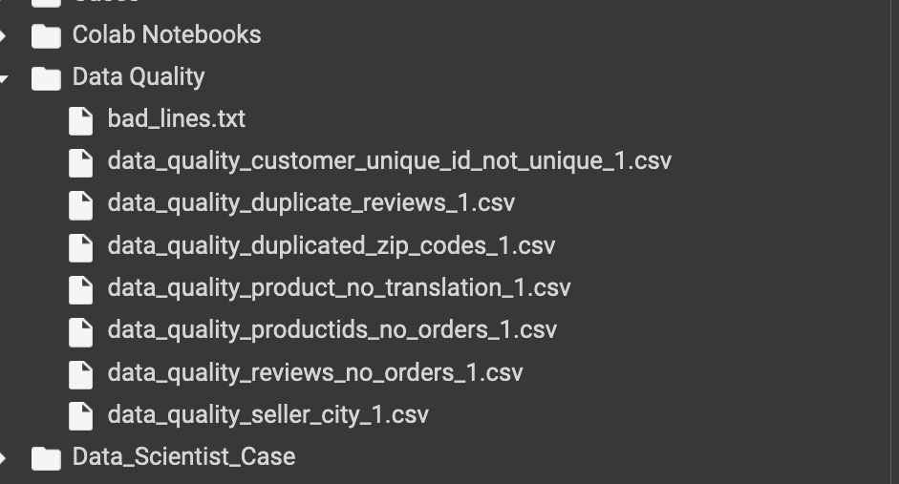

Data Quality Reporting
Workflow was built to automatically extract and store reports. Booleans were built to highlight issues in joined sets
TO DO
An excellent next steps would require to build analytics around the data quality to help the teams track and clean-up
Notes:
Tools and procedures:
Discuss procedure for getting to solution.
Discuss the tools and technologies you have used.

Slide 10
Demo & Solution
Notes:
Tools and procedures:
Discuss procedure for getting to solution.
Discuss the tools and technologies you have used.

Slide 11
Tools and Procedures
Notes:
Tools and procedures:
Discuss procedure for getting to solution.
Discuss the tools and technologies you have used.

Slide 12








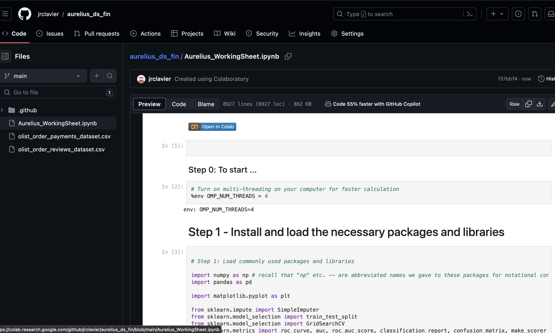
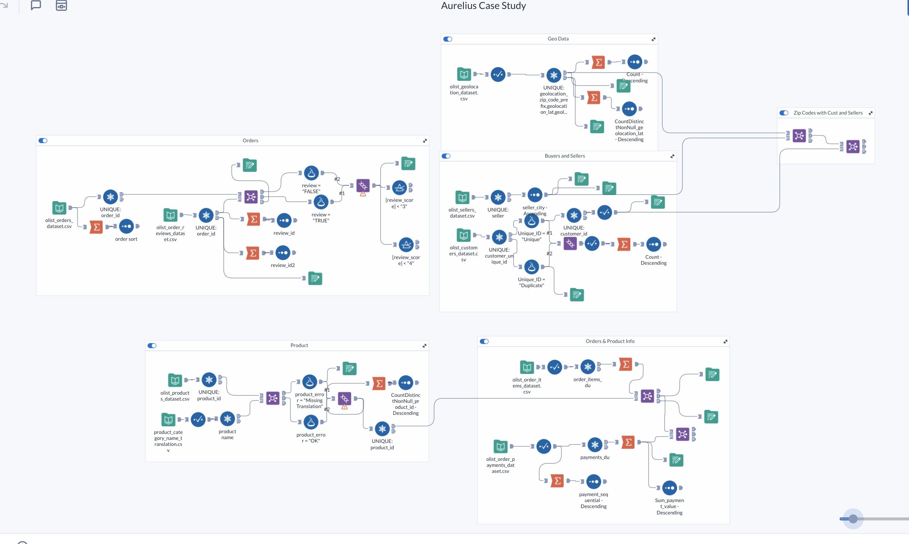
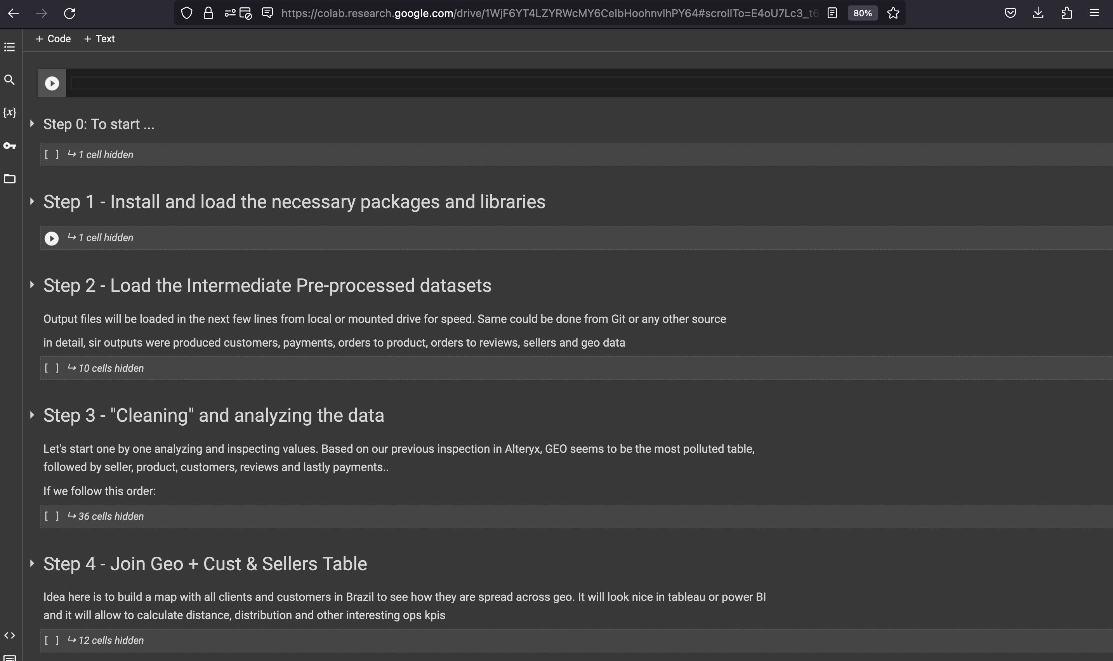
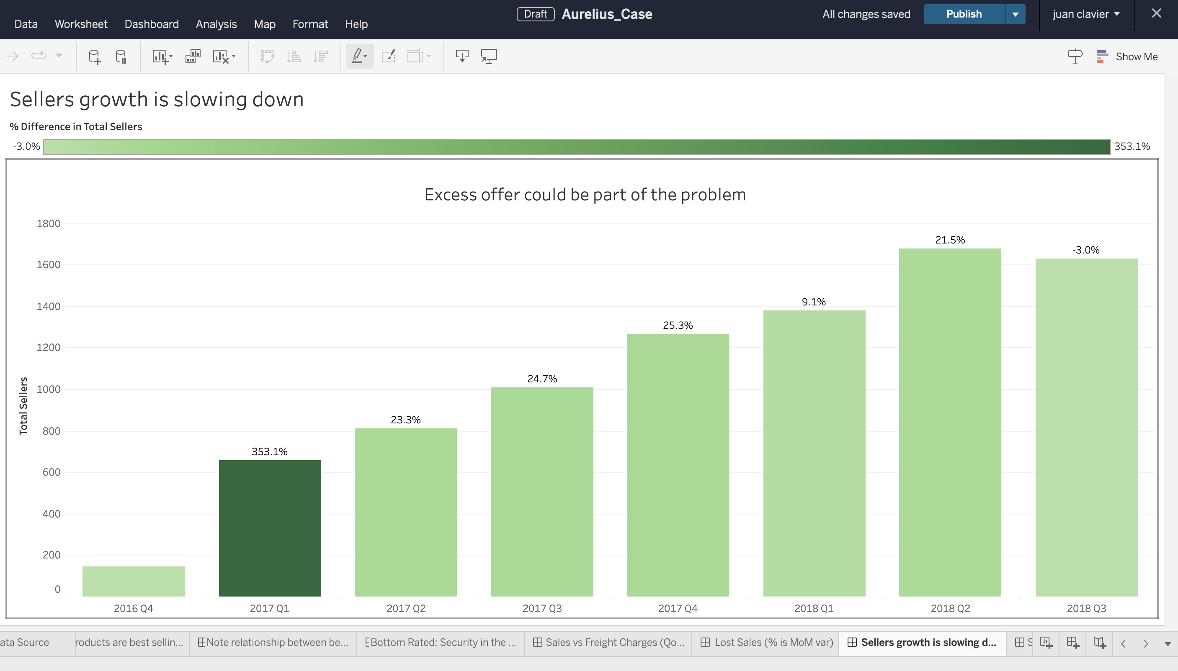
Architecture of the Solution
Ingestion & Control
Data Exploration
Analysis & Model
Data Visualization
Solution built to allow for easy replacement of connectors
Alteryx Model is good for fast analysis but not scalable
Google Colab+ python used share and visualize the model
Output tables shared via connector to tableau web

Slide 13
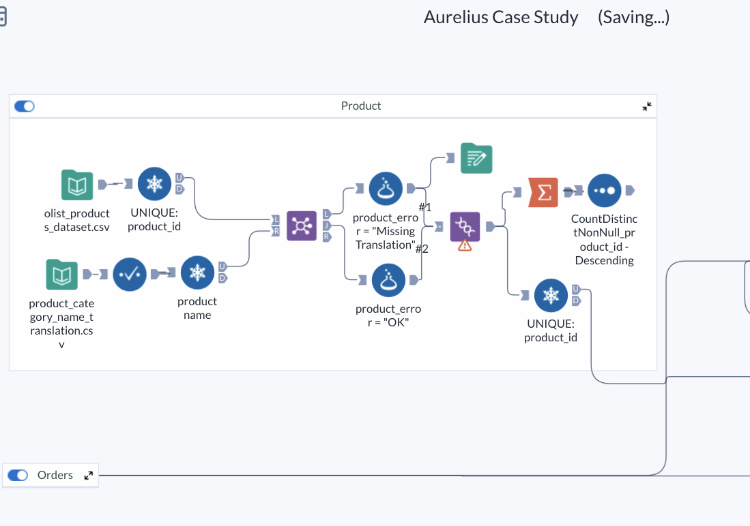
Data Exploration: Alteryx
ETL - Overview
Exploration and Clean-up
Cloud Based Workflow: Performed the majority the data quality checks and transformations
Easy-to-use: via containers for an easier explanation and sharing blocks with basic operators but also custom
Live connectors: to all major providers (snowflake, AWS, Azure, tableau)
Limitations→ not recommended for large models (slow, propensity to break) good for quick prototyping
Notes:
very large middle class, income extremely concentrated in southeast (rio, sp), high price sensitivity, people actually compare prices and a lot, highly connected (leads many usage metrics on whatsapp globally), ecommerce is big but still improving due to logistic challenges, I'd say mercado livre has the top position and other players like magazine luiza are very strong, amazon still figuring out it's strategy (people still go to it for books), inflation is still quite volatile and does impact willingness to consume, people are mostly happy and have active sexual lives
Introduction of proposed user case:
Provide a brief overview of the user case scenario relevant to the Senior Data Scientist position.
"a Brazilian e-commerce platform, has experienced a plateau in sales and a decline in buyer activity despite seller stability. The goal is to identify the root causes and propose solutions to revitalize growth."

Slide 14
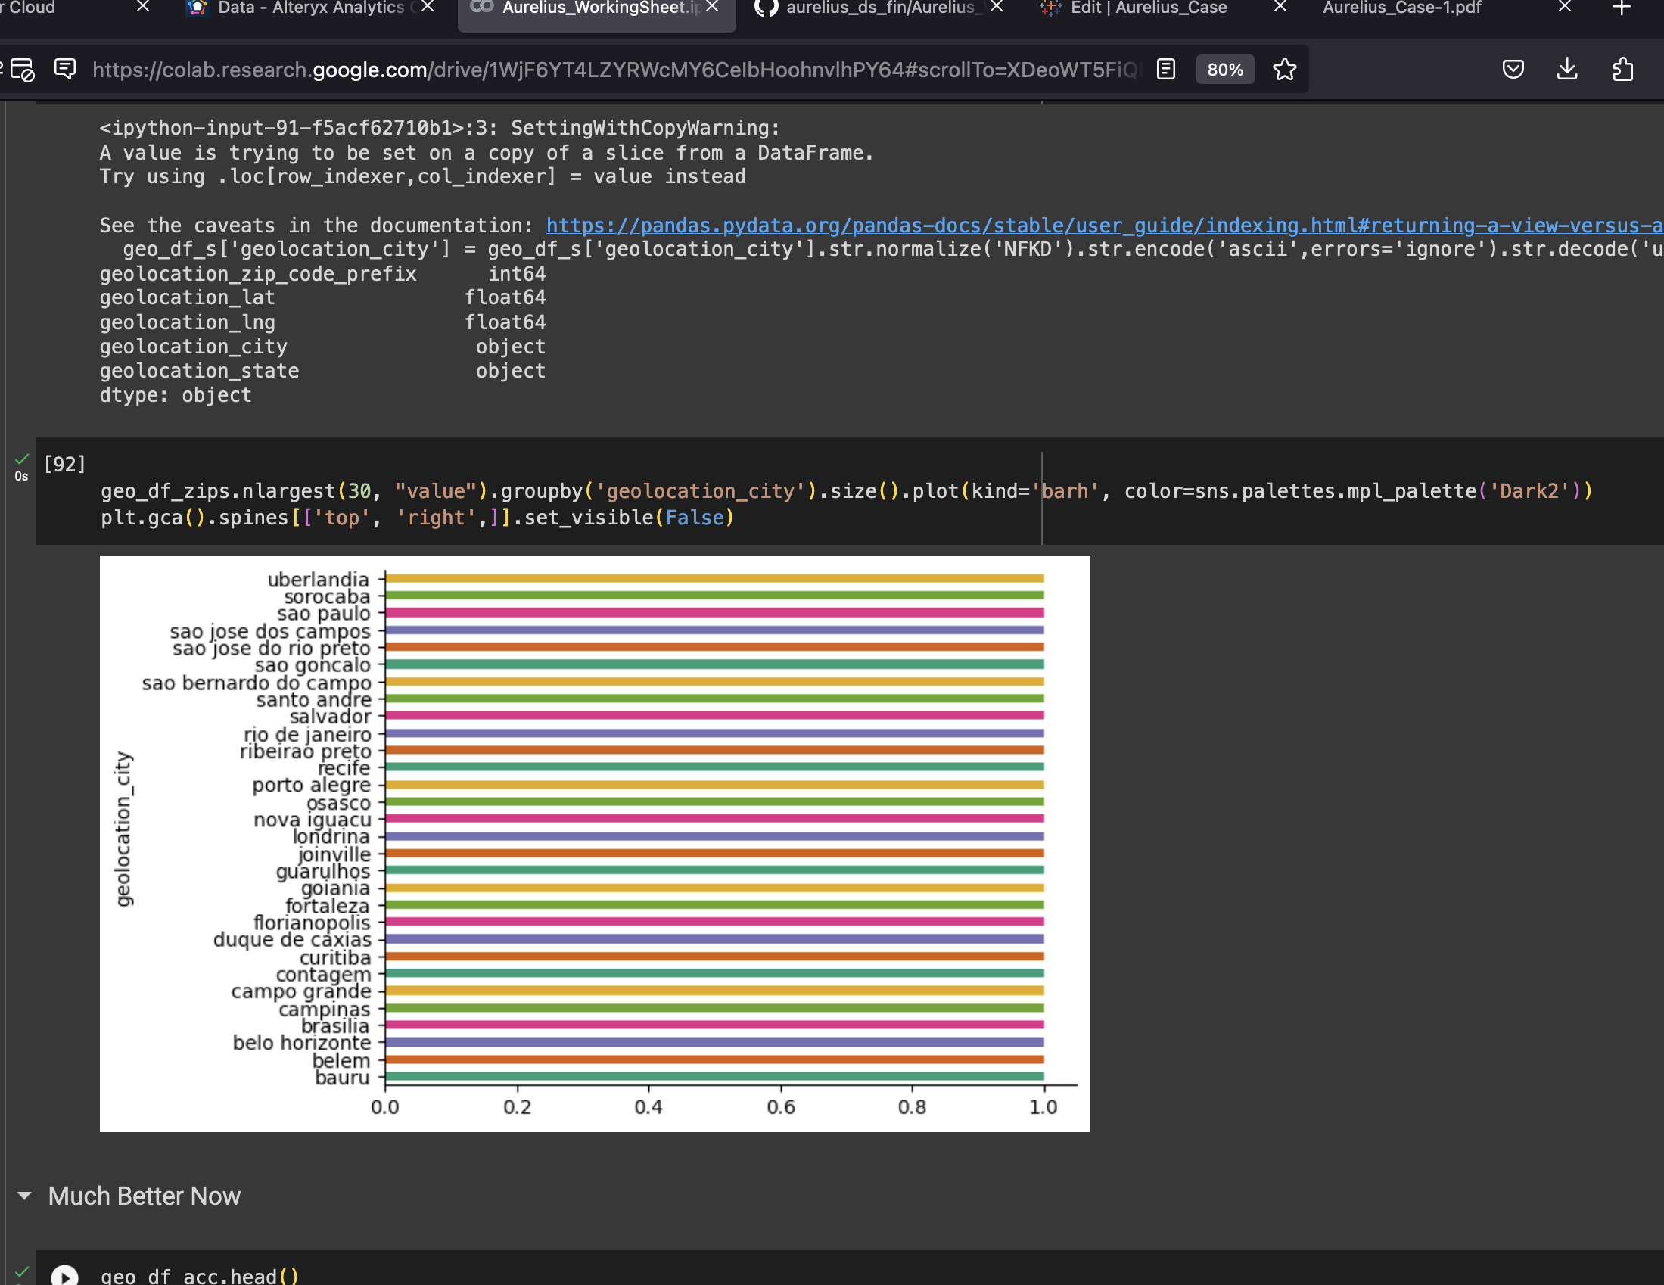
Modeling: Colab
Overview
Code available for discussion
Colab→ Google web-based IDE similar to jupyter, etc
Python-based code: all major packages were loaded (step 1) and used (Pandas, numpy, pyplot, etc)
Code governance: clear distinction between declarations, transformations, analysis, stats and ML models (in that order)
Limitations→ need expertise, hard to share insights in a business context
Notes:
very large middle class, income extremely concentrated in southeast (rio, sp), high price sensitivity, people actually compare prices and a lot, highly connected (leads many usage metrics on whatsapp globally), ecommerce is big but still improving due to logistic challenges, I'd say mercado livre has the top position and other players like magazine luiza are very strong, amazon still figuring out it's strategy (people still go to it for books), inflation is still quite volatile and does impact willingness to consume, people are mostly happy and have active sexual lives
Introduction of proposed user case:
Provide a brief overview of the user case scenario relevant to the Senior Data Scientist position.
"a Brazilian e-commerce platform, has experienced a plateau in sales and a decline in buyer activity despite seller stability. The goal is to identify the root causes and propose solutions to revitalize growth."

Slide 15
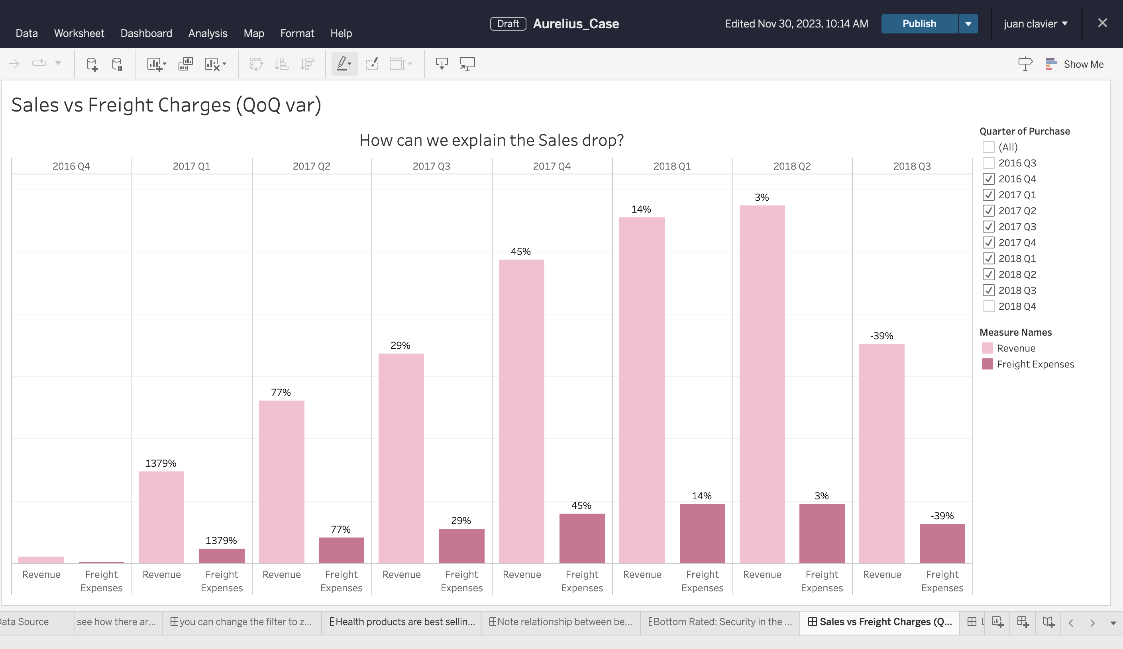
Front-end: Tableau
Overview
Web-trial version
Workbooks→ 22 workbooks created with visualizations and calculated KPIs
Easy-to-use: visualizations available along with the capacity of extracting data for further analysis (Finance)
UI-UX: good tool to share business insights and reports but not visually appealing
Limitations→ Can be slow with large datasets, licensing costs
Notes:
very large middle class, income extremely concentrated in southeast (rio, sp), high price sensitivity, people actually compare prices and a lot, highly connected (leads many usage metrics on whatsapp globally), ecommerce is big but still improving due to logistic challenges, I'd say mercado livre has the top position and other players like magazine luiza are very strong, amazon still figuring out it's strategy (people still go to it for books), inflation is still quite volatile and does impact willingness to consume, people are mostly happy and have active sexual lives
Introduction of proposed user case:
Provide a brief overview of the user case scenario relevant to the Senior Data Scientist position.
"a Brazilian e-commerce platform, has experienced a plateau in sales and a decline in buyer activity despite seller stability. The goal is to identify the root causes and propose solutions to revitalize growth."

Slide 16
Thank you
Notes:
https://medium.com/samaipata-ventures/cheat-sheet-1-key-kpis-to-track-for-marketplaces-75827d9fc0a8

